Slide 1


Microprocessors and Assembly Language Spring 2020
Hamed Farbeh
farbeh@aut.ac.ir
Department of Computer Engineering
Amirkabir University of Technology
Lecture 19

Slide 2
Copyright Notice
Parts (text & figures) of this lecture are adopted from:
Arm Assembly Language Programming and Architecture, Volume 1, 1st edition, Muhammad Ali Mazidi, Sarmad Naimi, and Sepehr Naimi, MicroDigitalEd, 2013.
Microprocessors and Assembly Language, Spring 2020, AUT, Tehran, Iran

Slide 3
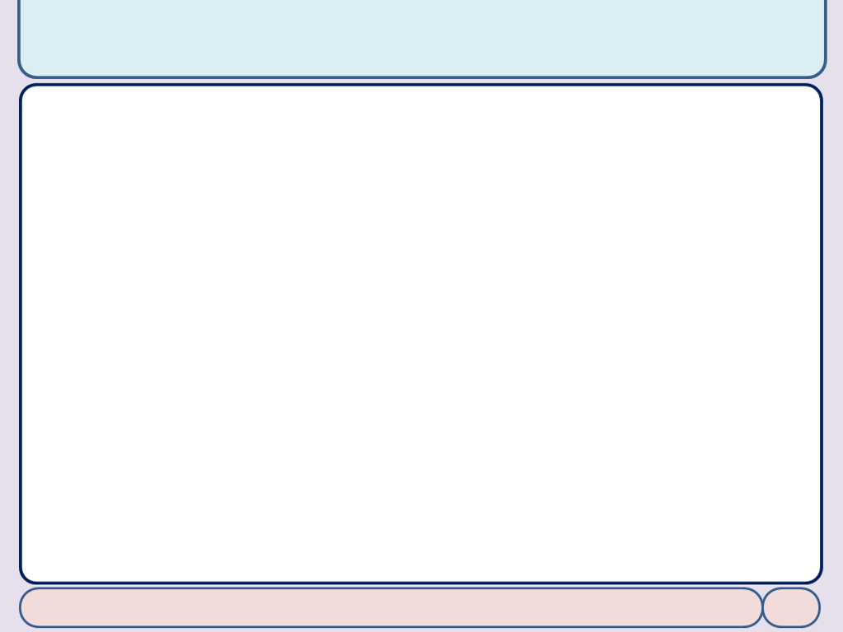
Arithmetic and Logic Instructions and Programs
Microprocessors and Assembly Language, Spring 2020, AUT, Tehran, Iran

Slide 4
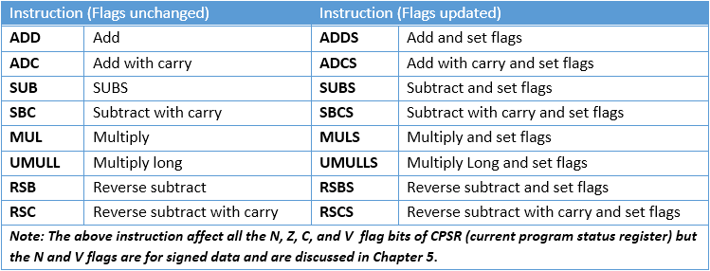
Arith. Instr. and Flag Bits for Unsigned Data
No increment instr. In ARM
Use the available ADD instr.
Microprocessors and Assembly Language, Spring 2020, AUT, Tehran, Iran

Slide 5
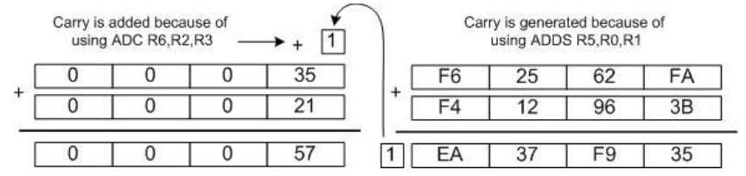
Multiword ADD and SUB
Add 0x35F62562FA to 0x21F412963B
LDR R0, =0xF62562FA; R0 = 0xF62562FA
LDR R1, =0xF412963B; R1 = 0xF412963B
MOV R2, #0x35; R2 = 0x35
MOV R3, #0x21; R3 = 0x21
ADDS R5, R1, R0; R5 = 0xF62562FA + 0xF412963B ; now C = 1
ADC R6, R2, R3; R6 = R2 + R3 + C; = 0x35 + 21 + 1 = 0x57
Microprocessors and Assembly Language, Spring 2020, AUT, Tehran, Iran

Slide 6
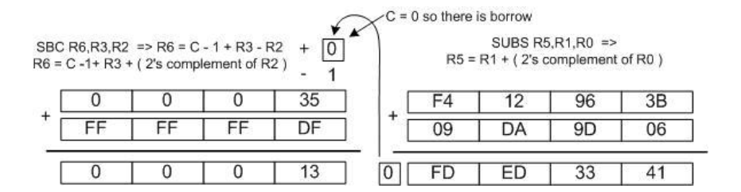
Multiword ADD and SUB
Sub 0x21F62562FA from 0x35F412963B
LDR R0, =0xF62562FA; R0 = 0xF62562FA ; notice the syntax for LDR
LDR R1, =0xF412963B; R1 = 0xF412963B
MOV R2, #0x21; R2 = 0x21
MOV R3, #0x35; R3 = 0x35
SUBS R5, R1, R0; R5 = R1 – R0; = 0xF412963B – 0xF62562FA, and C = 0
SBC R6, R3, R2; R6 = R3 – R2 – 1 + C; = 0x35 – 0x21 – 1 + 0 = 0x13
Microprocessors and Assembly Language, Spring 2020, AUT, Tehran, Iran

Slide 7
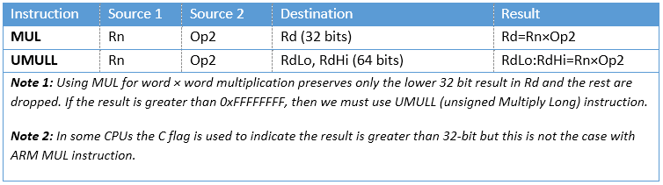
Multiplication and Division of Unsigned Numbers
Not all CPUs have instr. for mult. and div.
All the ARM processors have mult., but not all have div.
ARM Cortex-M3 and M4 have both mult. and div.
MUL: Regular multiplication
MULL: long multiplication
Microprocessors and Assembly Language, Spring 2020, AUT, Tehran, Iran

Slide 8
Multiplication of Unsigned Numbers
MUL: Regular multiplication
MULL: long multiplication
LDR R1, =100000; R1=100,000
LDR R2, =150000; R2=150,000
MUL R3, R2, R1; R3 is not 15,000,000,000; it cannot fit in 32 bits.
LDR R1, =0x54000000; R1 = 0x54000000
LDR R2, =0x10000002; R2 = 0x10000002
UMULL R3, R4, R2, R1; 0x54000000 × 0x10000002 = 0x054000000A8000000; R3 = 0xA8000000, the lower 32 bits
; R4 = 0x05400000, the higher 32 bits
Microprocessors and Assembly Language, Spring 2020, AUT, Tehran, Iran

Slide 9
Multiplication of Unsigned Numbers
Multiply and Accumulate Instructions in ARM
MLA Rd, Rm, Rs, Rn ; Rd = Rm × Rs + Rn
MOV R1, #100; R1 = 100
MOV R2, #5; R2 = 5
MOV R3, #40; R3 = 40
MLA R4, R1, R2, R3; R4 = R1 × R2 + R3 = 100 × 5 + 40 = 540
To accumulate the products of the multiplication
MLA R3, R1, R2, R3; R3 = R1 × R2 + R3 or R3 += R1 × R2
UMLAL: unsigned multiply and accumulate long
UMLAL RdLo, RdHi, Rn, Op2; RdHi:RdLo = Rn × Op2 + RdHi:RdLo
Microprocessors and Assembly Language, Spring 2020, AUT, Tehran, Iran

Slide 10
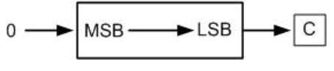
Rotate and Barrel Shifter
LSR: Logical shift right
MOV R0, #0x9A; R0 = 0x9A
MOVS R1, R0, LSR #3; shiftR R0 3 times, then store the result in R1
MOV R0, #0x9A
MOV R2, #0x03
MOVS R1, R0, LSR R2; shiftR R0 R2 times; and move the result to R1
Microprocessors and Assembly Language, Spring 2020, AUT, Tehran, Iran

Slide 11
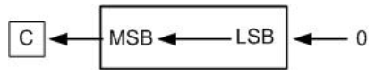
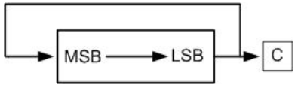
Rotate and Barrel Shifter
LSL: Logical shift left
MOV R1, R1, LSL R2
ROR: Rotate right
MOVS R1, R1, ROR #1
MOVS R1, R1, ROR R0
Microprocessors and Assembly Language, Spring 2020, AUT, Tehran, Iran

Slide 12
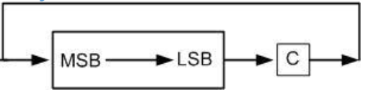
Rotate and Barrel Shifter
NO ROL: Rotate left
Use ROR for rotating left
n-bit ROL ⬄ (32 - n)-bit ROR
Take care of carry
RRX: Rotate right through carry
Takes no arguments
MOVS R2, R2, RRX; Rotate 1 bit
Microprocessors and Assembly Language, Spring 2020, AUT, Tehran, Iran

Slide 13

Rotating Immediate Arguments
MOV Instruction
MOV R0, #0xFF, #2; R0 = 0xFF is rotated right 2 times. R0 = 0xC000003F
MOV R0, #0xFF, #12; R0 = 0xFF is rotated right 12 times. R0 = 0x0FF00000
MOV R0, #0xFF, #28; R0 = 0xFF is rotated right 28 times. R0 = 0x00000FF0
BUT, Rotate field (bit₁₁-bit₈) is 4-bit
Microprocessors and Assembly Language, Spring 2020, AUT, Tehran, Iran

Slide 14
Rotating Immediate Arguments
Shift instruction
MOV R0, R2, LSL #8 ⬄ LSL R0, R2, #8
ASR: Arithmetic Shift right
ASR Rd, Rm, Rn
ASRS Rd, Rm, Rn
LSL: Logical Shift Left
LSL Rd, Rm, Rn
…
Microprocessors and Assembly Language, Spring 2020, AUT, Tehran, Iran

Slide 15
BCD and ASCII Conversion
Unpacked BCD: each decimal digit is represented by a byte
0000 1001 0000 0101 ⬄ 95
Packed BCD: two decimal digits are packed in one byte
1001 0101 ⬄ 95
ASCII to unpacked BCD conversion
Get rid of the "011" in the upper 3 bits of the 7-bit ASCII
ASCII number is ANDed with "0000 1111“
ASCII to packed BCD conversion
First convert to unpacked BCD (remove the upper 3 bits)
Combine every two digits to make a packed BCD
Microprocessors and Assembly Language, Spring 2020, AUT, Tehran, Iran

Slide 16
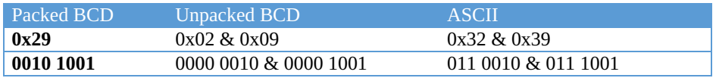
BCD and ASCII Conversion
Packed BCD to ASCII conversion
Convert packed BCD to unpacked BCD
Tagged with 011 0000 (0x30)
Microprocessors and Assembly Language, Spring 2020, AUT, Tehran, Iran

Slide 17
End of Chapter 3!
Microprocessors and Assembly Language, Spring 2020, AUT, Tehran, Iran

